Slide 1
CS-US TRAILS

Slide 2
NEGATIVE pictures

Slide 3
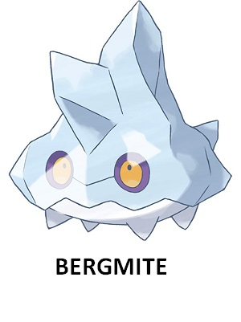
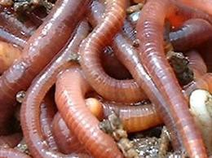

Slide 4
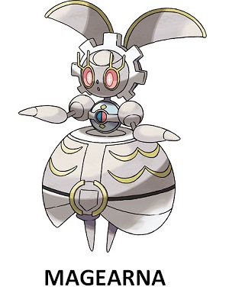

Slide 5
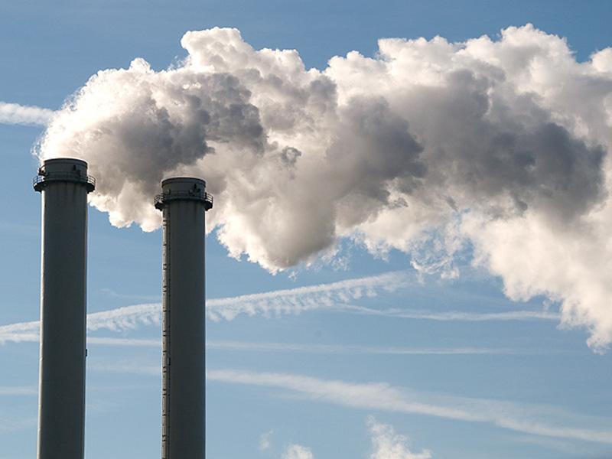

Slide 7
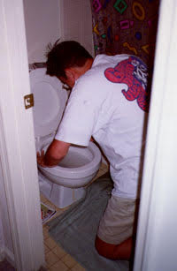

Slide 9
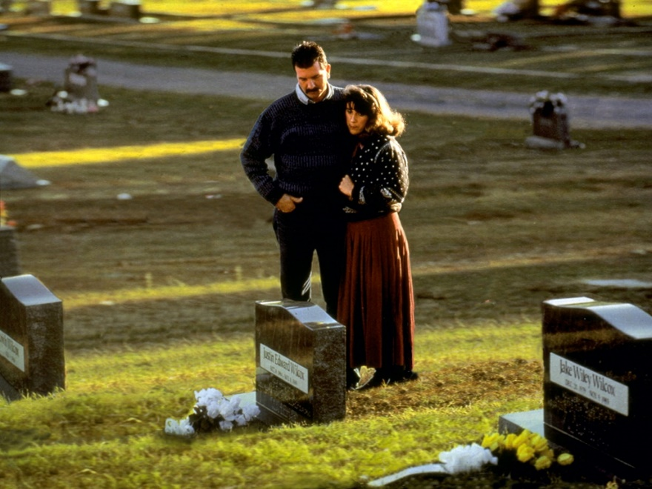

Slide 11
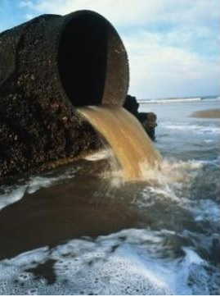

Slide 13
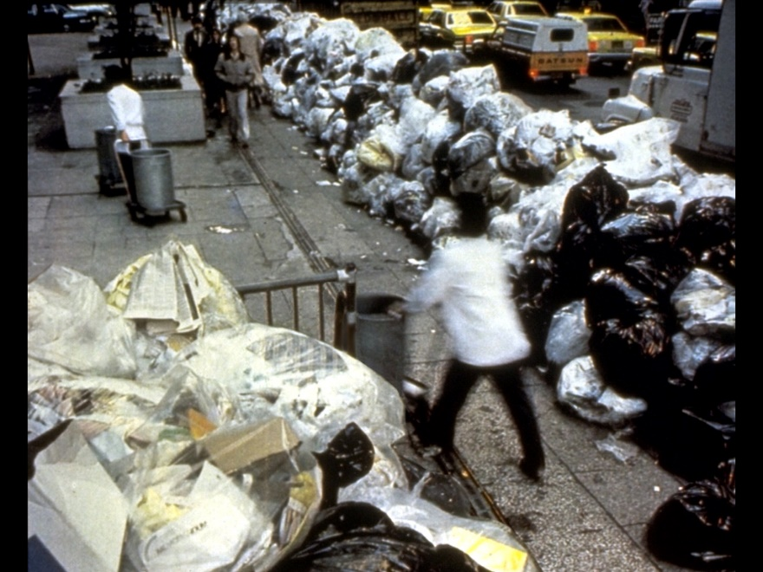

Slide 15
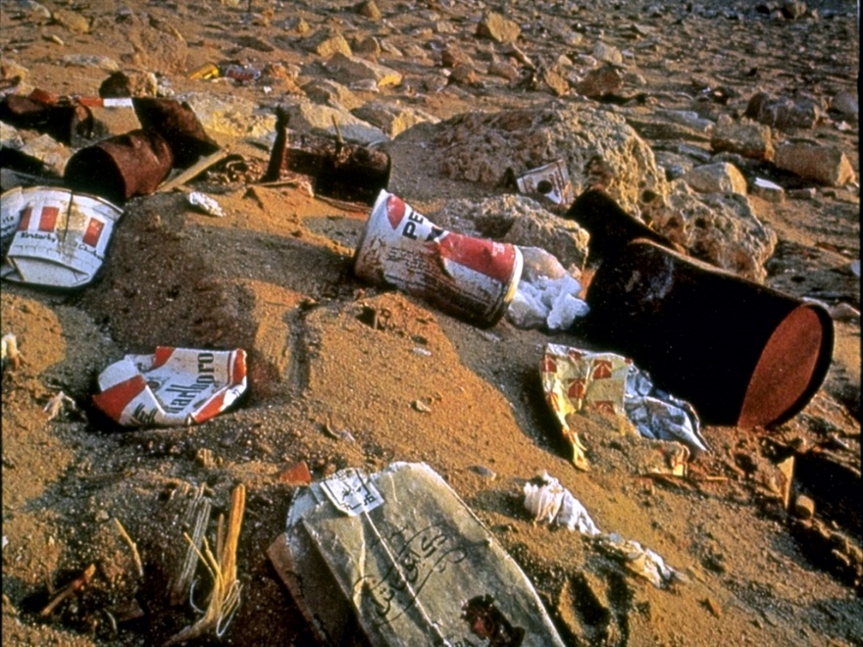

Slide 17
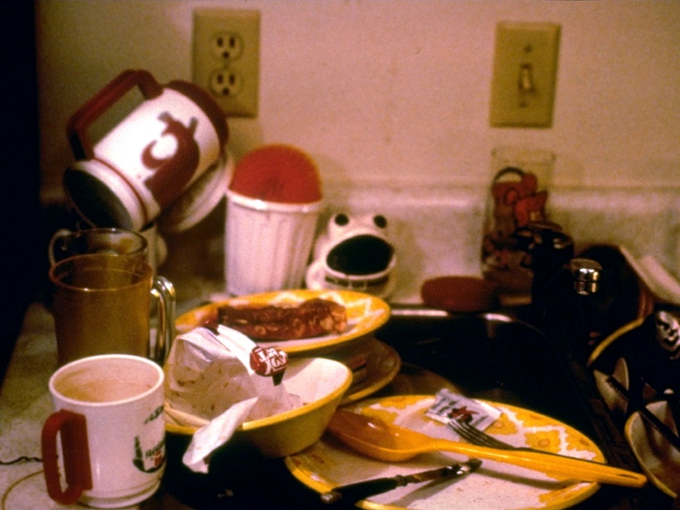

Slide 19
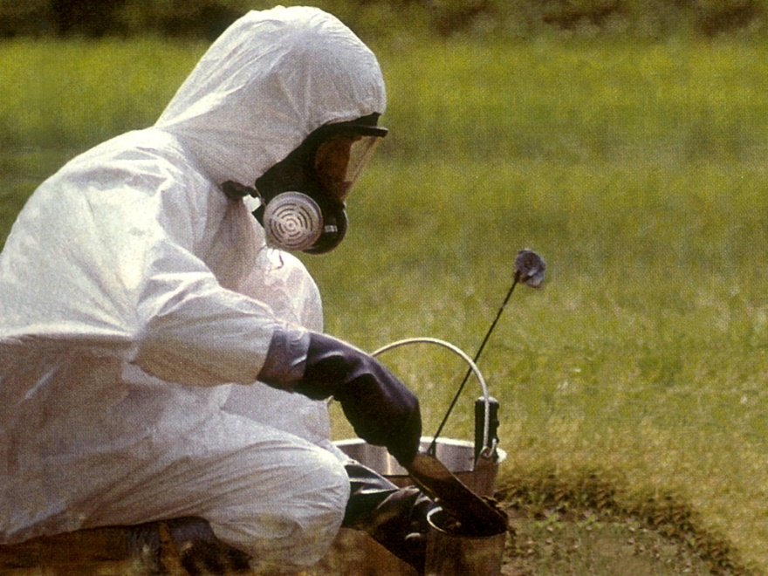

Slide 21
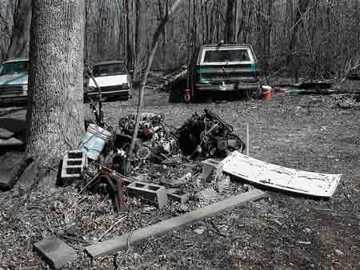

Slide 23
POSITIVE pictures

Slide 24
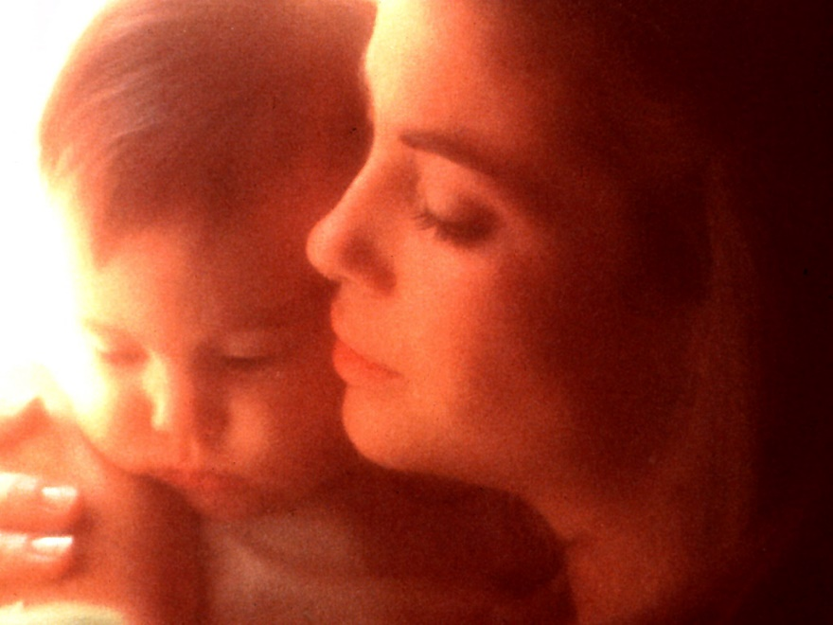

Slide 26
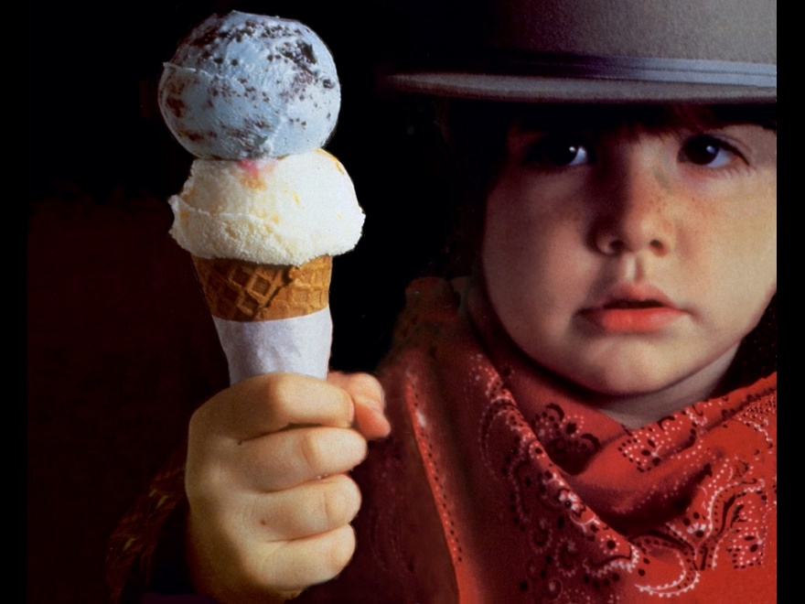

Slide 28
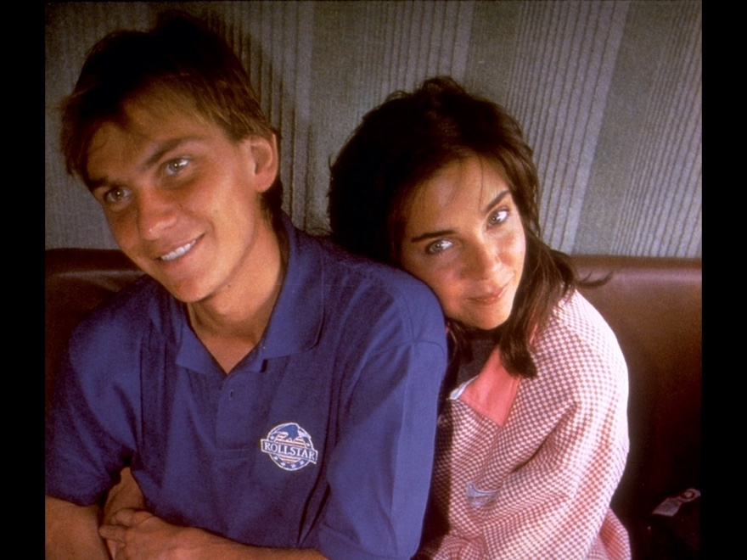

Slide 30
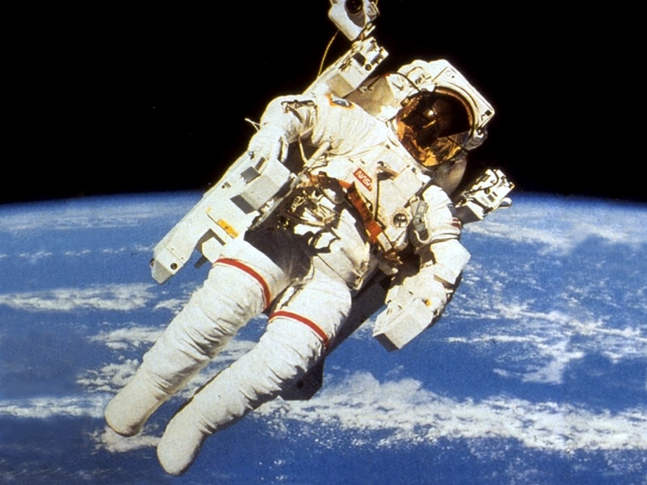

Slide 32
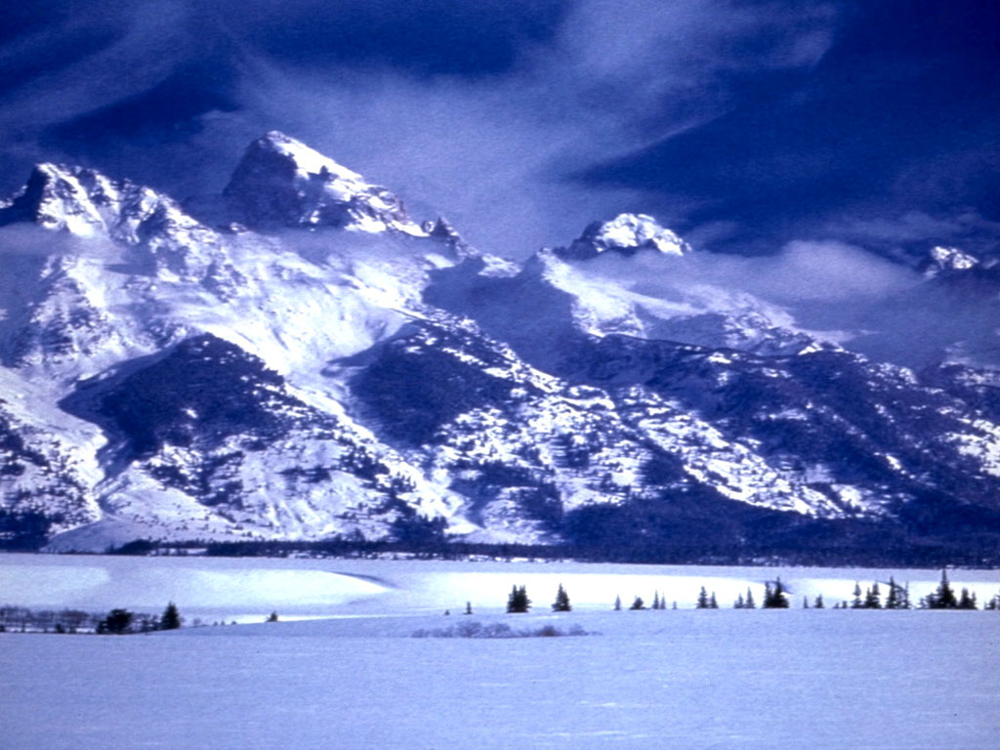

Slide 34
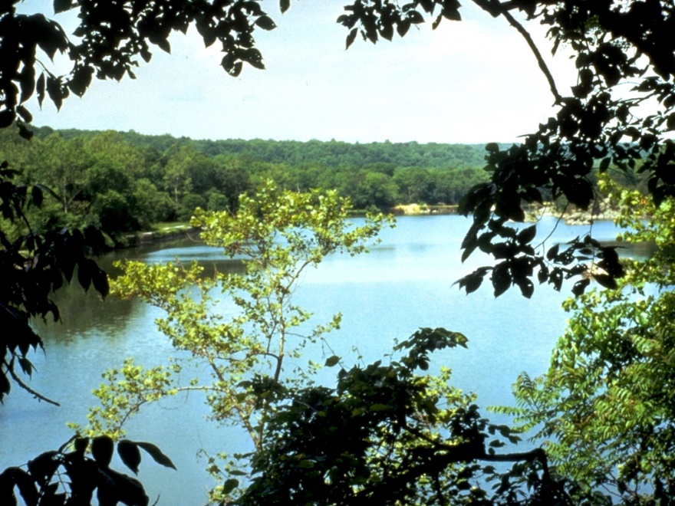

Slide 36
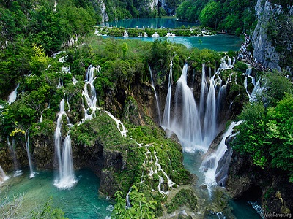

Slide 38
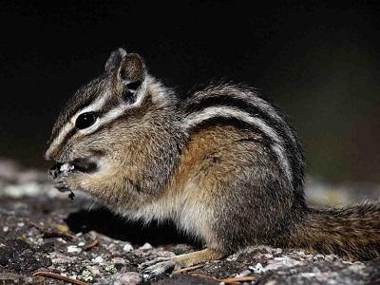

Slide 40


Slide 42
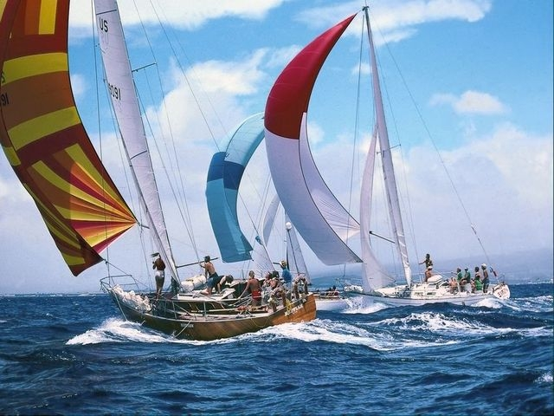

Slide 44
NEG WORDS

Slide 45
INFERIOR

Slide 46
INFERIOR

Slide 47
HARMFUL

Slide 48
HARMFUL

Slide 49
OFFENSIVE

Slide 50
OFFENSIVE

Slide 51
TROUBLESOME

Slide 52
TROUBLESOME

Slide 53
UPSETTING

Slide 54
UPSETTING

Slide 55
TERRIFYING

Slide 56
TERRIFYING

Slide 57
UNHEALTHY

Slide 58
UNHEALTHY

Slide 59
USELESS

Slide 60
USELESS

Slide 61
DISLIKABLE

Slide 62
DISLIKABLE

Slide 63
UNDESIRABLE

Slide 64
UNDESIRABLE

Slide 65
Positive words

Slide 66
USEFUL

Slide 67
USEFUL

Slide 68
CALMING

Slide 69
CALMING

Slide 70
DESIRABLE

Slide 71
DESIRABLE

Slide 72
APPEALING

Slide 73
APPEALING

Slide 74
WORTHWHILE

Slide 75
WORTHWHILE

Slide 76
RELAXING

Slide 77
RELAXING

Slide 78
BENEFICIAL

Slide 79
BENEFICIAL

Slide 80
VALUABLE

Slide 81
VALUABLE

Slide 82
TERRIFIC

Slide 83
TERRIFIC

Slide 84
COMMENDABLE

Slide 85
COMMENDABLE

